Slide 1
CG4002 Computer Engineering Capstone Project Individual Full Subsystem Test External Communications + Game Engine
Zhuang Jianning
A0214561M
B07

Slide 2
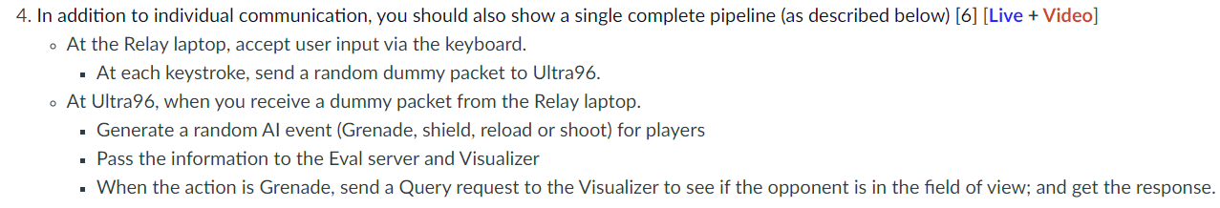
Demo Complete Pipeline with Game Engine
data packet corresponding to input action
update game state based on the data packet
Game state received by eval server should match expected game state

Slide 3
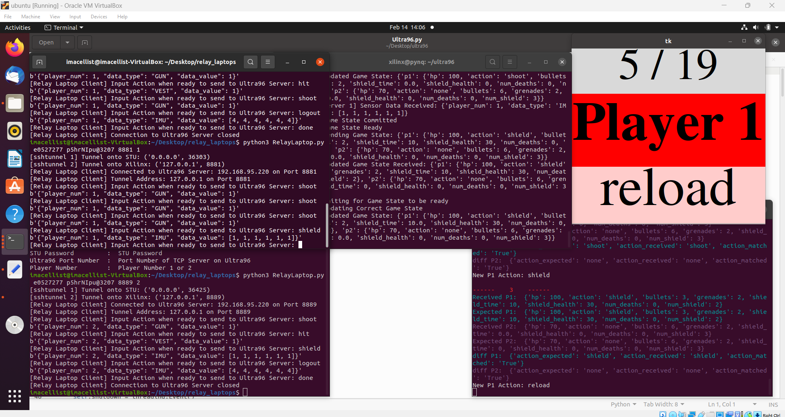
1 Player Game

Slide 4
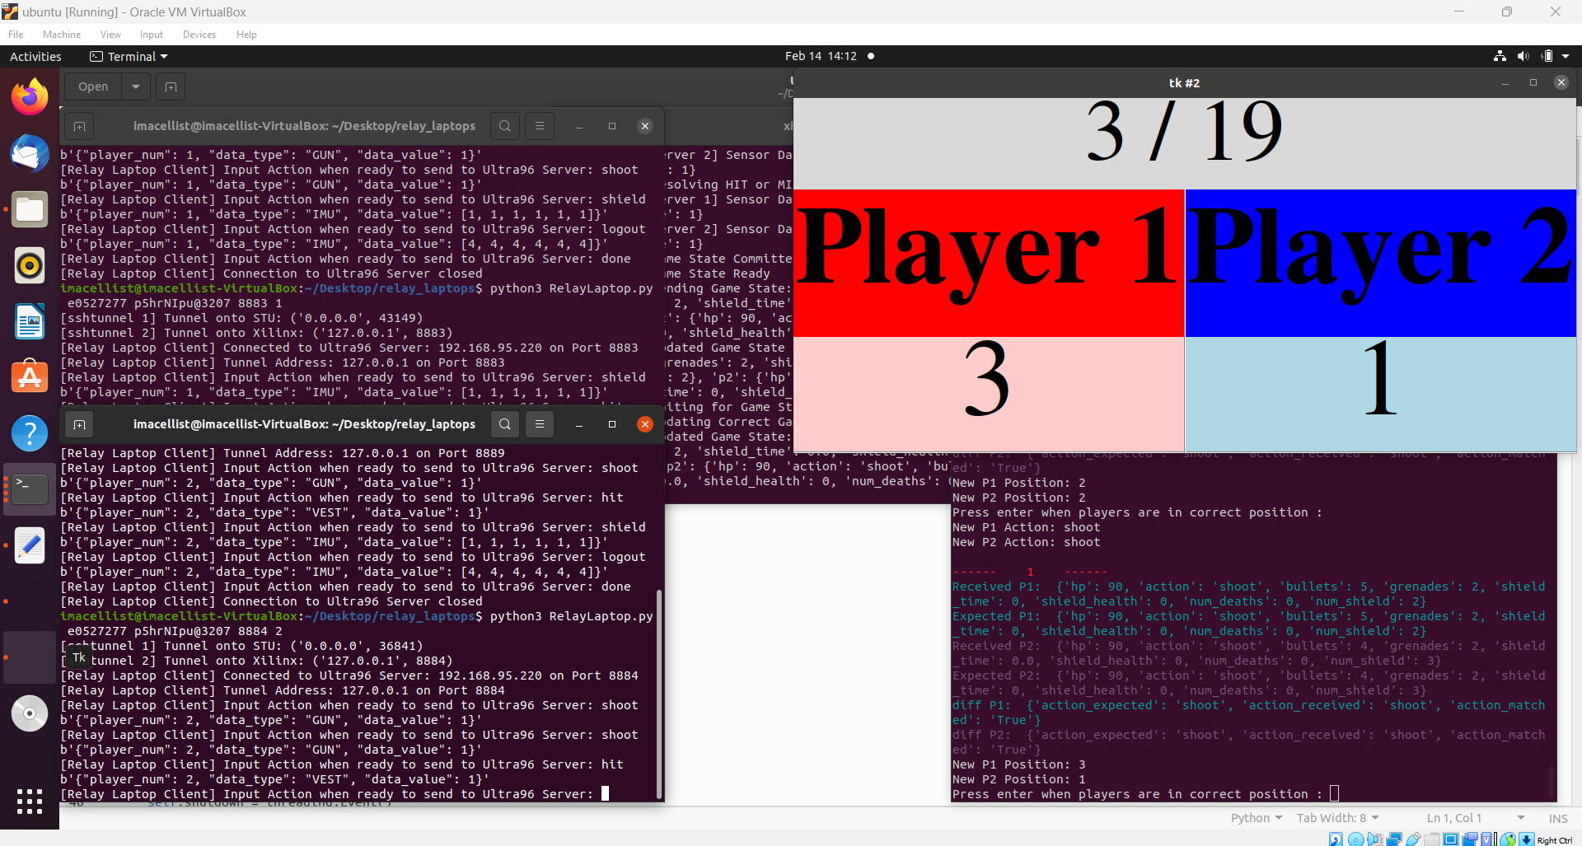
2 Player Game

Slide 5
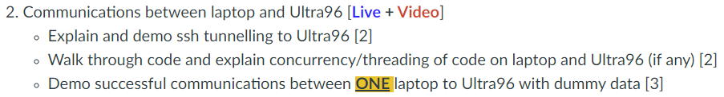
Relay Laptop <-> Ultra96

Slide 6
Ultra96 <-> Eval Server

Slide 7
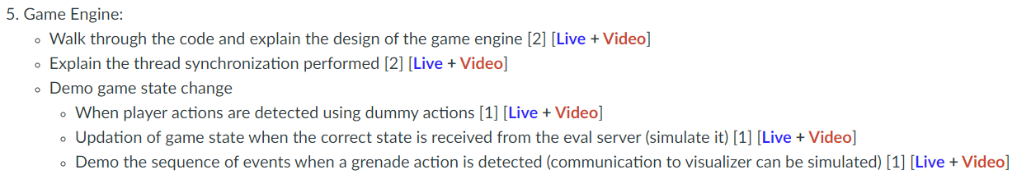
Game Engine

Slide 8
Thank You!

